Slide 1

Prediction of price of flight tickets

Slide 2




Introduction
Flight ticket prices can vary by hundreds of dollars annually, with some routes experiencing fluctuations exceeding 30% in price.
Advanced AI-driven flight ticket price prediction models can achieve prediction accuracy rates of around 85%, helping travelers make informed decisions.
The airline industry generates enormous amounts of data daily, with over 100 terabytes of flight and pricing data being processed and analyzed.
Predictive models can improve pricing accuracy by up to 20%, resulting in significant savings for travelers.

Slide 3

Problem Statement
How can we accurately predict flight ticket prices to help travelers save on costs and make more informed travel decisions?

Slide 4









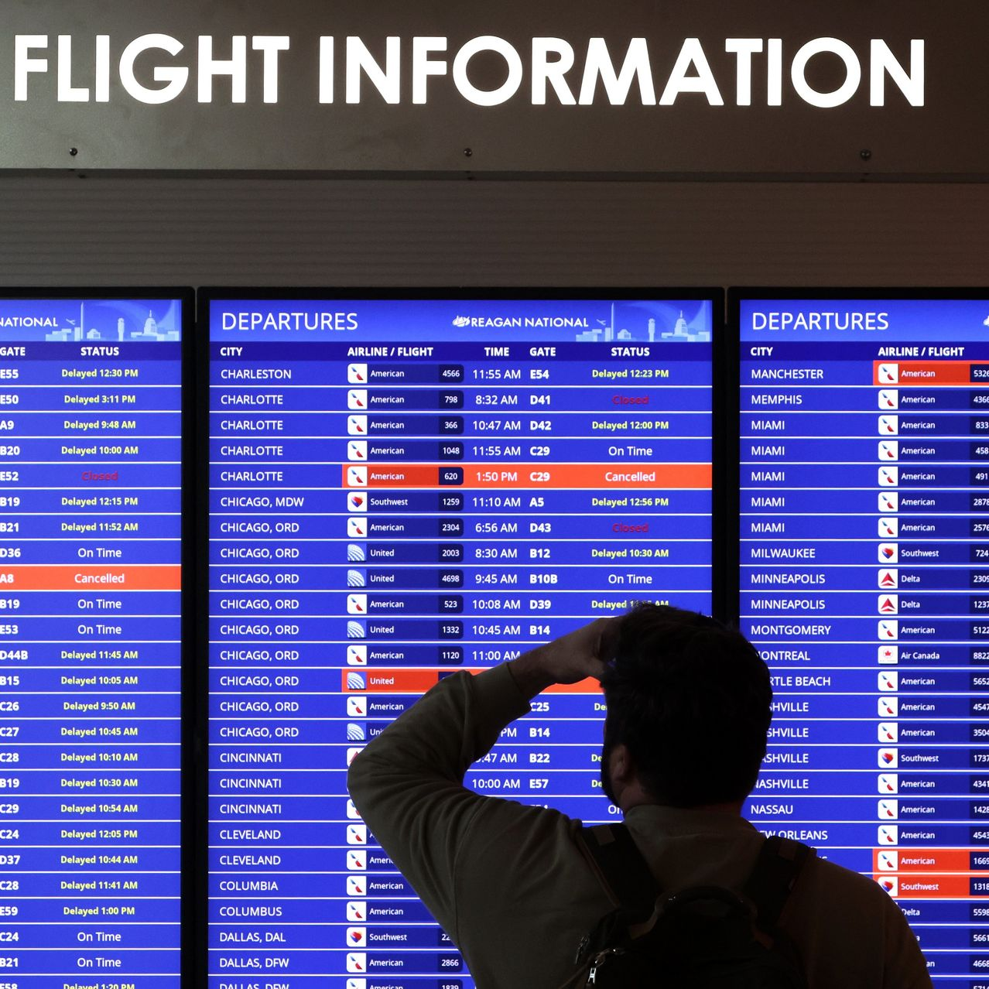
Dataset
Airline
Source
Destination
Price
The dataset is imported from kaggle.
In our dataset there are about 10684 instances.
Here the dependent variable is stroke.
In this dataset, as our dependent variable price is typically considered a continuous numerical variable. This is because ticket prices are expressed as numerical values and can take on a wide range of possible values within a continuous numeric range.
Date of journey
Number of Stops
Departure Time
Arrival Time
Route
Total Stops
Price (Dependent variable)

Slide 5
Steps
Import and Preprocess the data
Data Exploration
Label Encoding
Split Data
Train data with different algorithms
Test Data

Slide 6
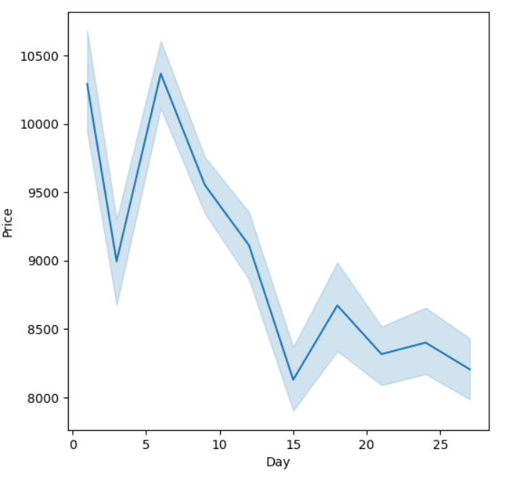
PRICE VARIATION OVER DAYS IN A MONTH

Slide 7
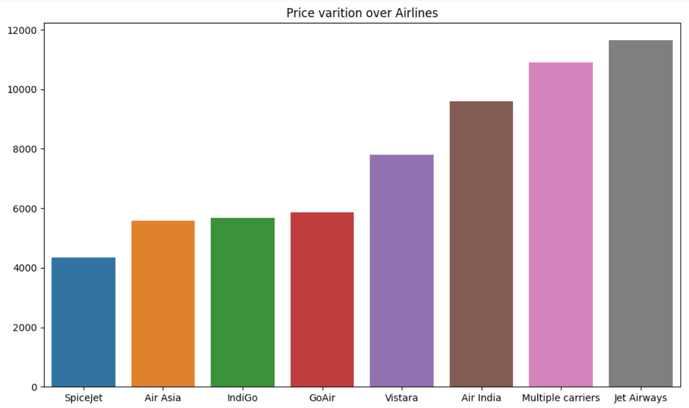
PRICE VARIATION OVER DIFFERENT AIRLINES

Slide 8
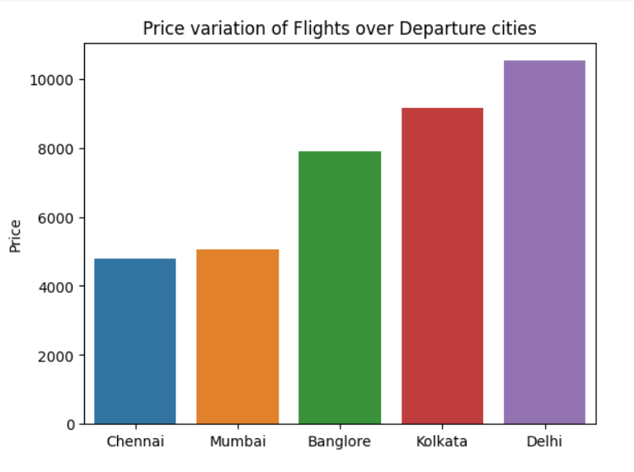
PRICE VARIATION OVER DEPARTURE CITIES

Slide 9
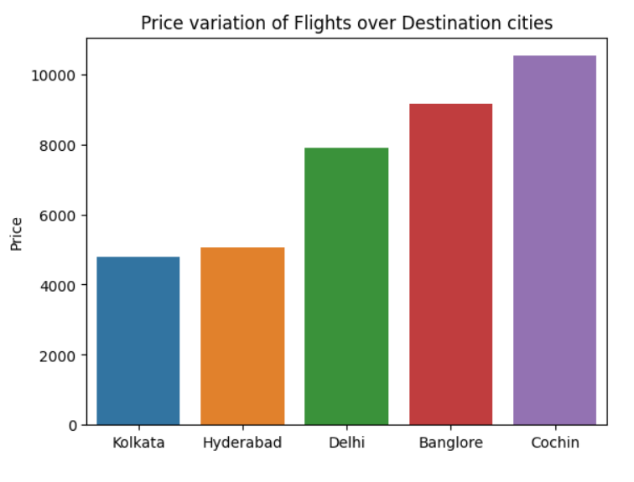
PRICE VARIATION OVER DESTINATION
CITIES

Slide 10
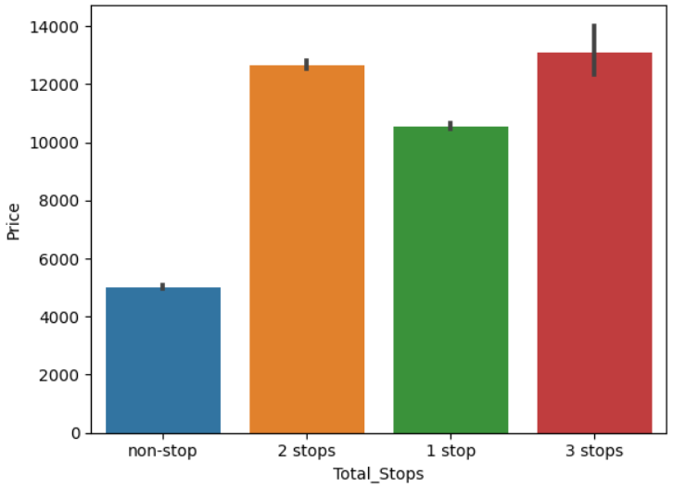
PRICE VARIATION BASED ON NO OF STOPS

Slide 11
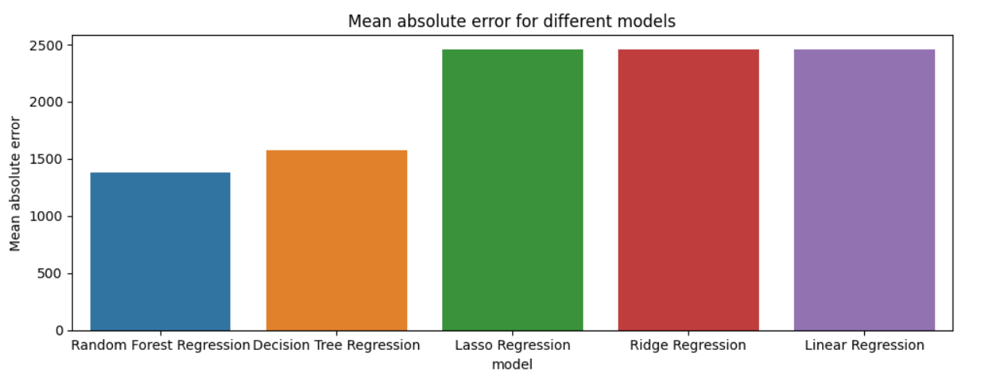
Evaluation for Different Models

Slide 12
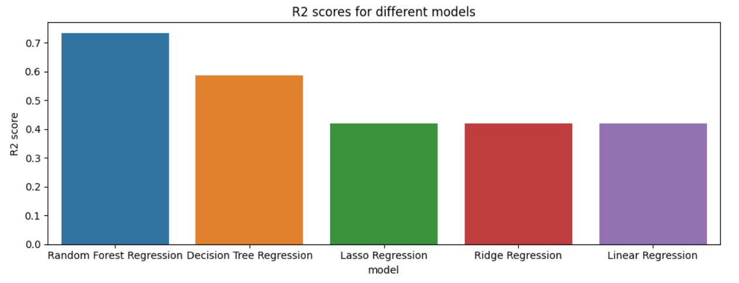
Evaluation for Different Models

Slide 13
Random Forest
Random Forest is a versatile ensemble learning method suitable for both classification and regression tasks, making it adaptable to a wide range of predictive tasks.
When evaluating models for predicting flight ticket prices, Random Forest regression consistently demonstrates strong performance, particularly in terms of R2 score. It excels at capturing complex relationships in the data.
Random Forest's ability to mitigate overfitting and produce robust, generalized models makes it a preferred choice in the context of flight price prediction.

Slide 14
Decision Tree
Decision Tree is a simple, yet effective machine learning algorithm used for both classification and regression tasks. It provides an easily interpretable structure that resembles a flowchart.
When evaluating models for predicting flight ticket prices, Decision Trees can offer reasonable performance. However, they may be more prone to overfitting complex data and require careful pruning and regularization.

Slide 15
Linear Regression
Linear Regression is a fundamental and widely used statistical modeling technique for establishing linear relationships between variables. It's primarily used for predicting a continuous outcome variable based on one or more predictor variables.
When studying factors related to flight ticket price prediction, Linear Regression can help identify and quantify the linear relationships between specific predictors.
Linear Regression is particularly valuable for understanding the strength and direction of associations between variables, making it a useful tool in the initial exploration and interpretation of factors contributing to the prediction of flight ticket prices.

Slide 16
Conclusion
Early prediction of flight prices also helps travelers plan and book their trips more cost-effectively, reducing the financial burden on individuals and families.
"If the risk of fluctuating flight prices is predicted earlier, travelers can take proactive measures to secure better deals before booking their flights”.

Slide 17

TEAM MEMBERS
ADITYA SAI MADDILA -U77227975
LEELA MAHESH CHAKRAVARTHY KODI -U28275523
VASUDEVA REDDY BOLLEDDULA - U44373196

